Slide 1
CSCE430/830 Computer Architecture
Instruction-level parallelism: Scoreboard
Lecturer: Prof. Hong Jiang
Courtesy of Yifeng Zhu (U. Maine)
Fall, 2006
Portions of these slides are derived from:
Dave Patterson © UCB

Slide 2
HW Scheme: Dynamic Scheduling
Static Scheduling
  Compiler techniques for scheduling
» separate dependent instructions
» minimize the number of hazard and stalls
e.g.: static branch prediction
Dynamic Scheduling
  1. Uses hardware to rearrange instructions to reduce stalls
2. Works when real dependence is not known at compile time
3. Compiler simpler
4. Code for one pipeline runs well on another pipeline

Slide 3
The Key idea of Dynamic Scheduling
Key Idea: Allow instructions behind stall to proceed. => Instructions executing in parallel. There are multiple execution units, so use them.
DIVD F0, F2, F4
ADDD F10, F0, F8
SUBD F12, F8, F14
  Enables out-of-order execution => out-of-order completion
Even though ADDD stalls, the
SUBD has no dependencies
and can run.
Dynamic pipeline scheduling overcomes the limitations of in-order pipelined execution by allowing out-of-order instruction execution.

Slide 4
Dynamic Scheduling With A Scoreboard
The scoreboard is a centralized hardware mechanism
  In order to execute an instruction as soon as its operands are available and no hazard conditions that prevent it.
It dynamically constructs the dependency graph by hardware for a window of instructions as they are issued in program order.
A scoreboard is a “data structure” that provides the information necessary for all pieces of the processor to work together.
(In Appendix A.8)
CDC6600 (1963)

Slide 5
The Key idea of Scoreboards
Out-of-order execution divides ID stage:
  1. Issue—decode instructions, check for structural hazards
  2. Read operands—wait until no data hazards, then read operands
Scoreboards allow instruction to execute whenever 1 & 2 hold, not waiting for prior instructions.
We will use In order issue, out of order execution, out of order commit ( also called completion)
First used in CDC6600 in 1963. Our example has been modified to fit for MIPS.
CDC had 4 FP units, 5 memory reference units, 7 integer units.
MIPS has 2 FP multiply, 1 FP adder, 1 FP divider, 1 integer.

Slide 6
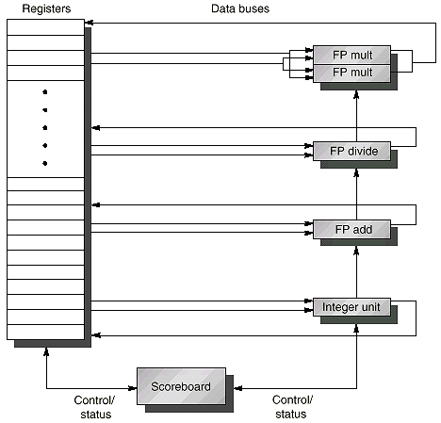
Typical Scoreboard Structure
2 FP multiply, 1 FP adder, 1 FP divider, 1 integer

Slide 7
Using A Scoreboard: 4 stages
1. Issue —decode instructions & check for structural & WAW hazards (ID1)
  If a functional unit for the instruction is free (no structural hazards) and no other active instruction has the same destination register (no WAW), the scoreboard issues the instruction to the functional unit and updates its internal data structure.
  If a structural or WAW hazard exists, then the instruction issue stalls, and no further instructions will issue until these hazards are cleared.
2. Read operands —wait until no data hazards, then read operands (ID2)
  A source operand is available if no earlier issued active instruction is going to write it, or if the register containing the operand is being written by a currently active functional unit (no RAW).
  When the source operands are available, the scoreboard tells the functional unit to proceed to read the operands from the registers and begin execution. The scoreboard resolves RAW hazards dynamically in this step, and instructions may be sent into execution out of order.
Always
done in
program
order
Can be
done
out of
program
order

Slide 8
Using A Scoreboard: 4 stages
3. Execution —operate on operands (EX)
  The functional unit begins execution upon receiving operands. When the result is ready, it notifies the scoreboard that it has completed execution.
4. Write result —finish execution (WB)
  Once the scoreboard is aware of the fact that the functional unit has completed execution, the scoreboard checks for WAR hazards. If none, it writes results. If WAR, then it stalls the instruction.
  Example:
  DIVD F0,F2,F4
  ADDD F10,F0,F8
  SUBD F8,F8,F14
  Scoreboard would stall SUBD until ADDD reads operands

Slide 9
Using A Scoreboard: 3 parts
1. Instruction status—which of 4 steps the instruction is in
2. Functional unit status—Indicates the state of the functional unit (FU). 9 fields for each functional unit
Busy—Indicates whether the unit is busy or not
Op—Operation to perform in the unit (e.g., + or –)
Fi—Destination register
Fj, Fk—Source-register numbers
Qj, Qk—Functional units producing source registers Fj, Fk
Rj, Rk—Flags indicating when Fj, Fk are ready. Set to No after operands are read.
3. Register result status—Indicates which functional unit will write each register, if one exists. Blank when no pending instructions will write that register
Notes:
What you might have thought
1. 4 stages of instruction executino
2.Status of FU: Normal things to keep track of (RAW & structura for busyl):
Fi from instruction format of the mahine (Fi is dest)
Add unit can Add or Sub
Rj, Rk - status of registers (Yes means ready)
Qj,Qk - If a no in Rj, Rk, means waiting for a FU to write result; Qj, Qk means wihch FU waiting for it
3.Status of register result (WAW &WAR)s:
which FU is going to write into registers
Scoreboard on 6600 = size of FU
6.7, 6.8, 6.9, 6.12, 6.13, 6.16, 6.17
FU latencies: Add 2, Mult 10, Div 40 clocks

Slide 10
A Scoreboard Example
The following code is run on the MIPS with a scoreboard given earlier with:
    L.D F6, 34(R2)
    L.D F2, 45(R3)
    MUL.D F0, F2, F4
    SUB.D F8, F6, F2
    DIV.D F10, F0, F6
    ADD.D F6, F8, F2
Functional Unit (FU) # of FUs EX cycles
Integer 1 1
Floating Point Multiply 2 10
Floating Point add 1 2
Floating point Divide 1 40
All functional units
are not pipelined
(similar to CDC6600)
Real Data Dependence (RAW)
Anti-dependence (WAR)
Output Dependence (WAW)

Slide 11
Dependency Graph For Example Code
1
Example Code
L.D F6, 34 (R2)
1
2
3
4
5
6
L.D F6, 34(R2)
L.D F2, 45(R3)
MUL.D F0, F2, F4
SUB.D F8, F6, F2
DIV.D F10, F0, F6
ADD.D F6, F8, F2
2
L.D F2, 45 (R3)
3
MUL.D F0, F2, F4
Date Dependence:
(1, 4) (1, 5) (2, 3) (2, 4)
(2, 6) (3, 5) (4, 6)
Output Dependence:
(1, 6)
Anti-dependence:
(5, 6)
4
SUB.D F8, F6, F2
5
DIV.D F10, F0, F6
Real Data Dependence (RAW)
Anti-dependence (WAR)
Output Dependence (WAW)
6
ADD.D F6, F8, F2

Slide 12
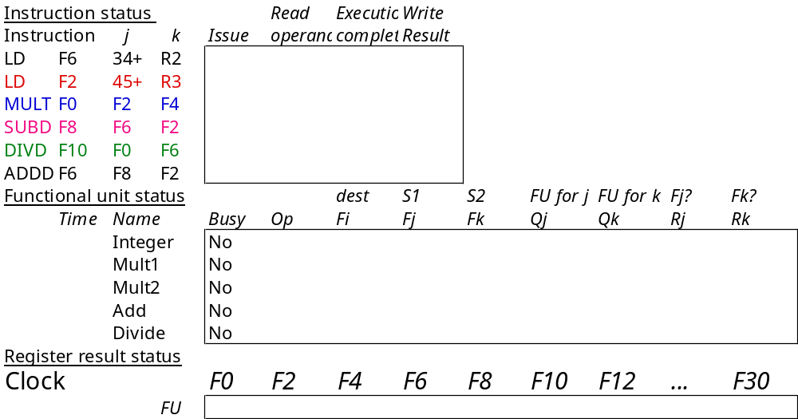
Scoreboard Example

Slide 13
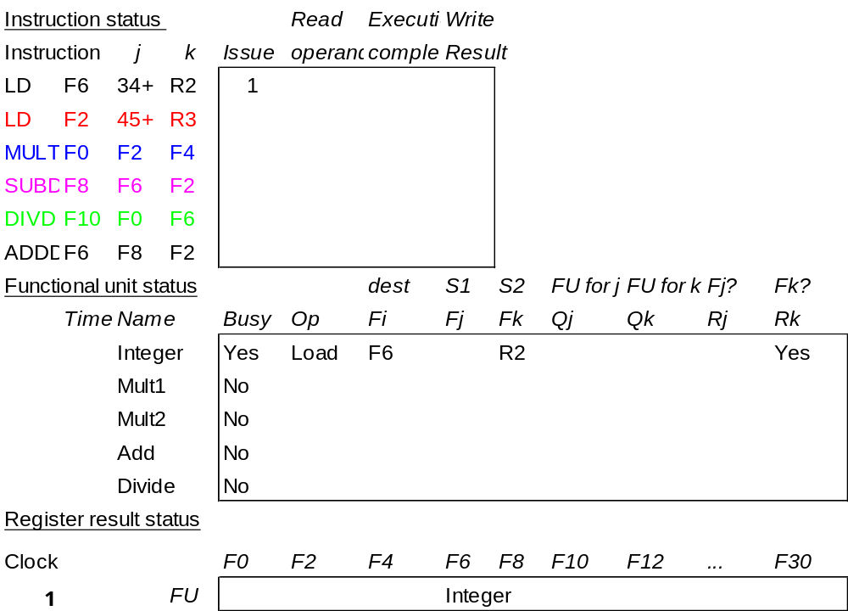
Scoreboard Example Cycle 1
Issue LD #1
Shows in which cycle the operation occurred.

Slide 14
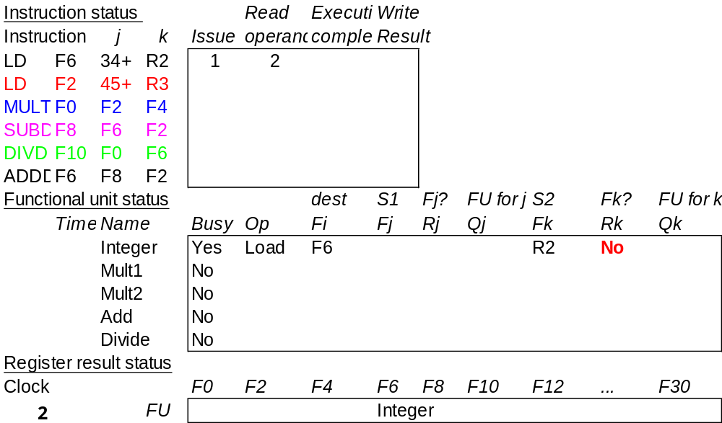
Scoreboard Example Cycle 2
LD #2 can’t be issued since integer unit is busy.
MULT can’t be issued coz issue should be in-order
Once RO of LD#2 started, make its Rj/Rk to “No”.

Slide 15
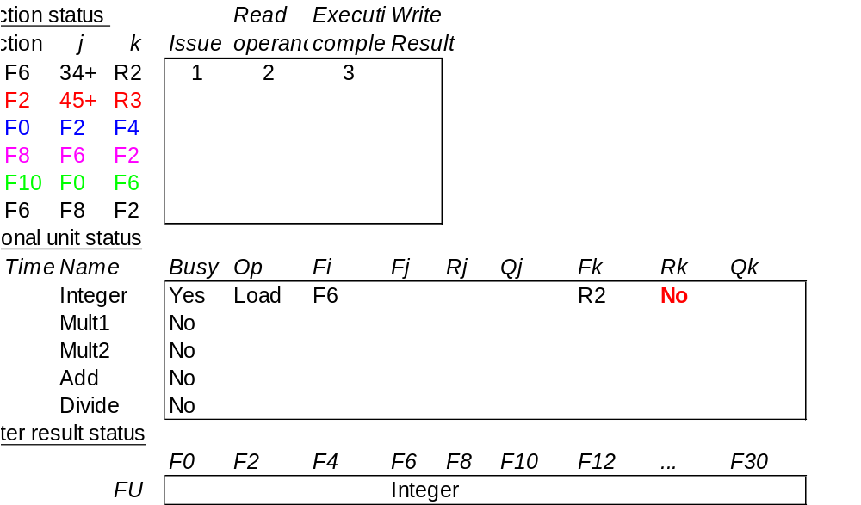
Scoreboard Example Cycle 3

Slide 16
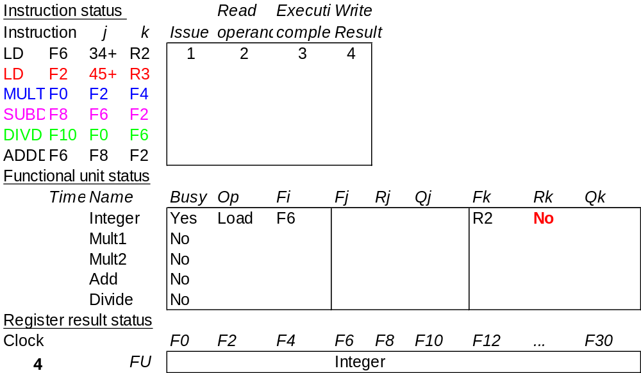
Scoreboard Example Cycle 4

Slide 17
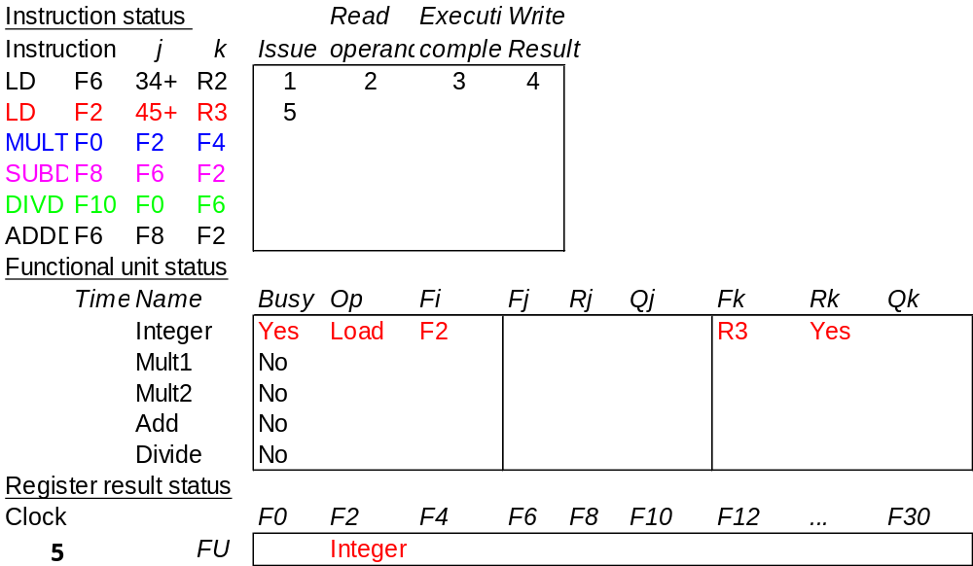
Scoreboard Example Cycle 5
Issue LD #2 since integer unit is now free.

Slide 18
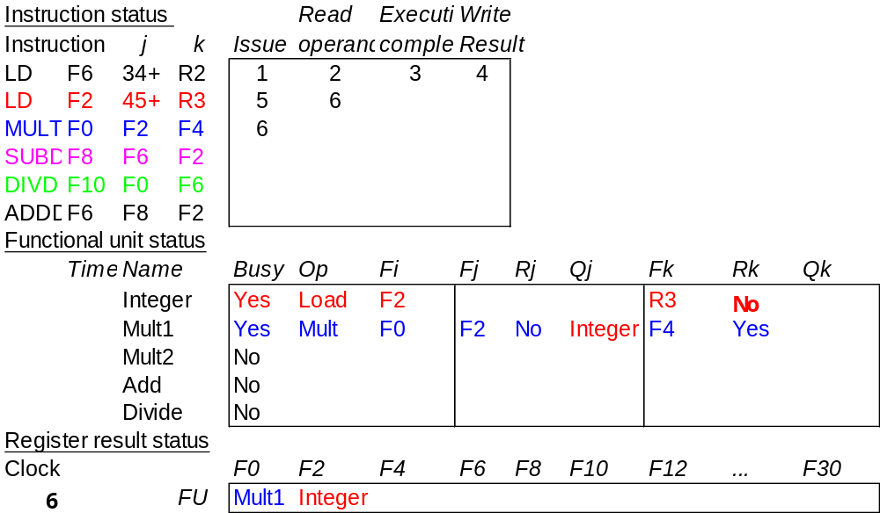
Scoreboard Example Cycle 6
Issue MULT.
As soon as LD #2’s RO took place, make its Rk field “No”.

Slide 19
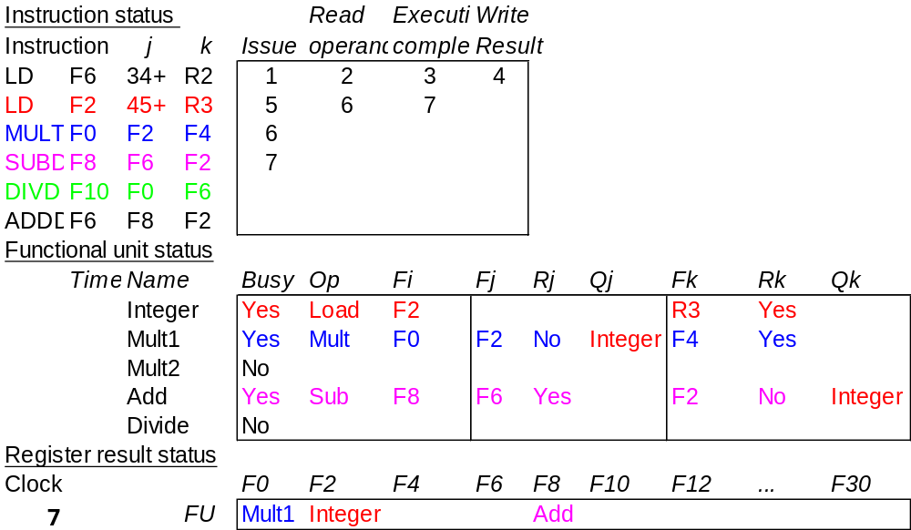
Scoreboard Example Cycle 7
MULT can’t read its operands (F2) because LD #2 hasn’t finished.

Slide 20
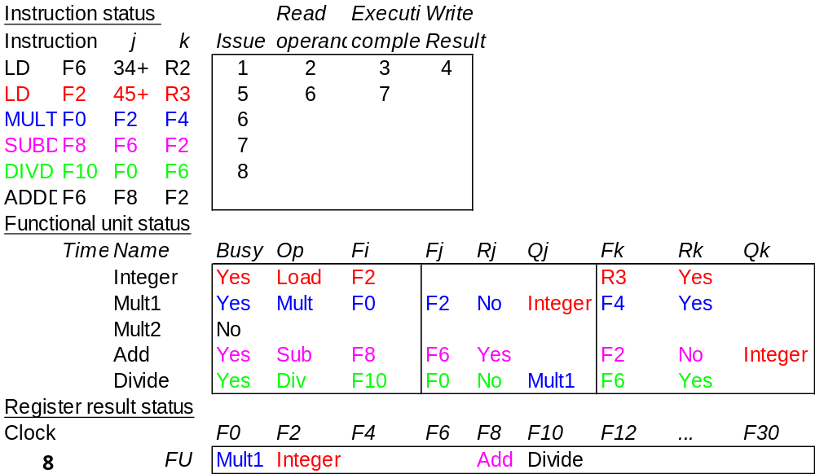
Scoreboard Example Cycle 8a
DIVD issues.
MULT and SUBD both waiting for F2.

Slide 21
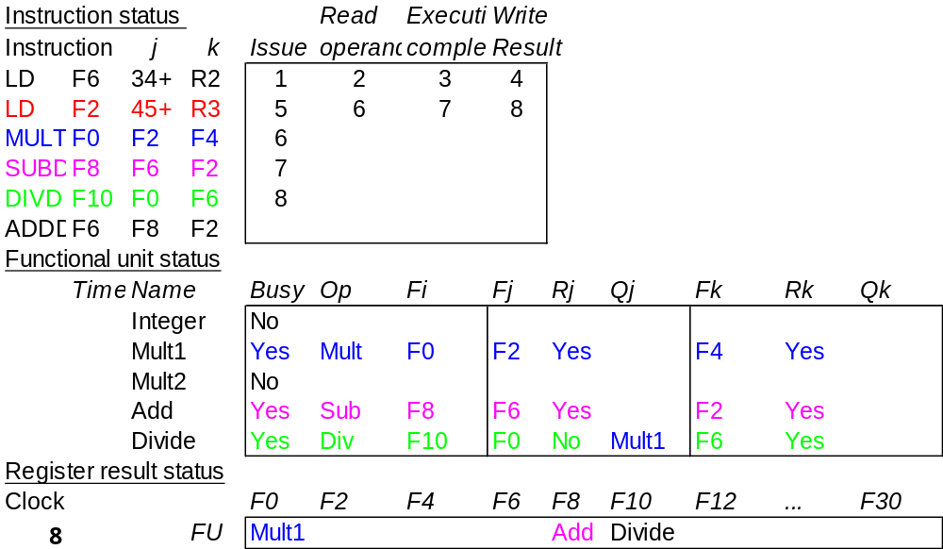
Scoreboard Example Cycle 8b
LD #2 writes F2.

Slide 22
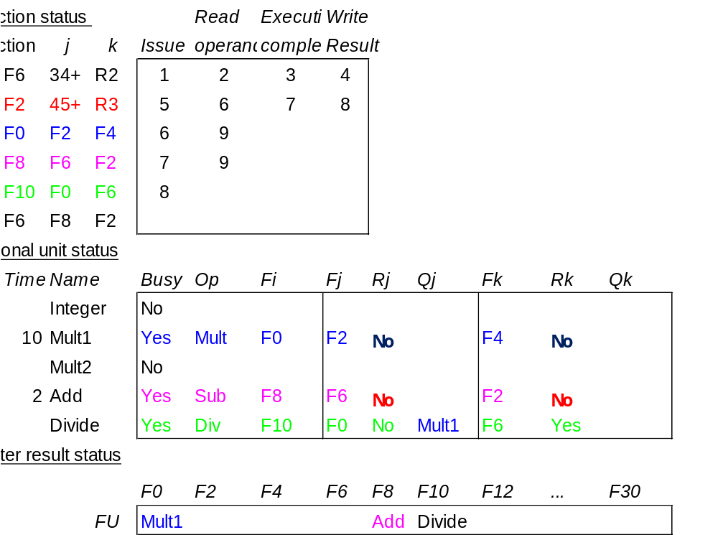
Scoreboard Example Cycle 9
Now MULT and SUBD can both read F2.
How can both instructions do this at the same time??

Slide 23
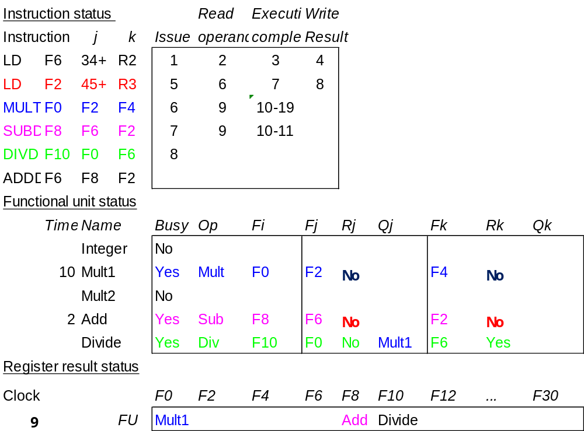
Scoreboard Example Cycle 10

Slide 24
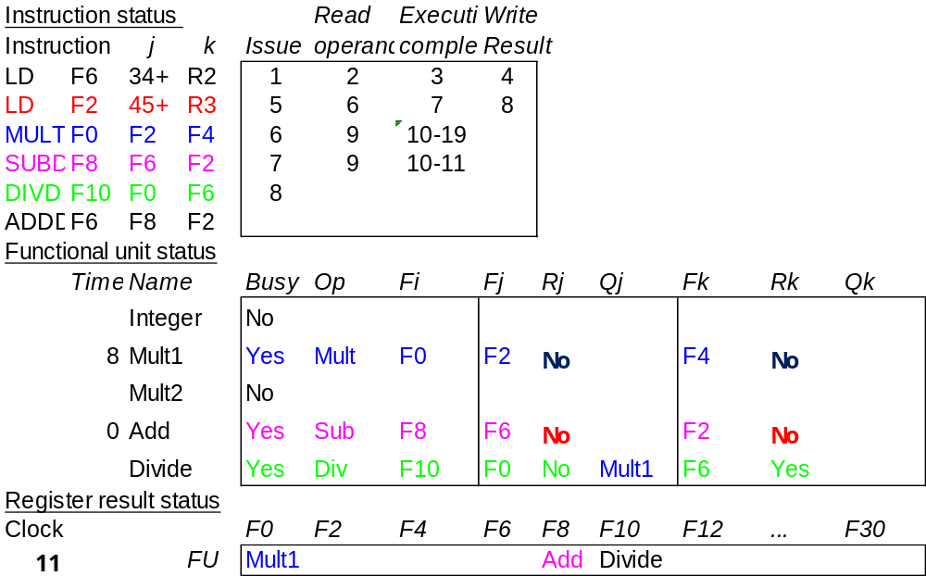
Scoreboard Example Cycle 11
ADDD can’t start because add unit is busy.

Slide 25
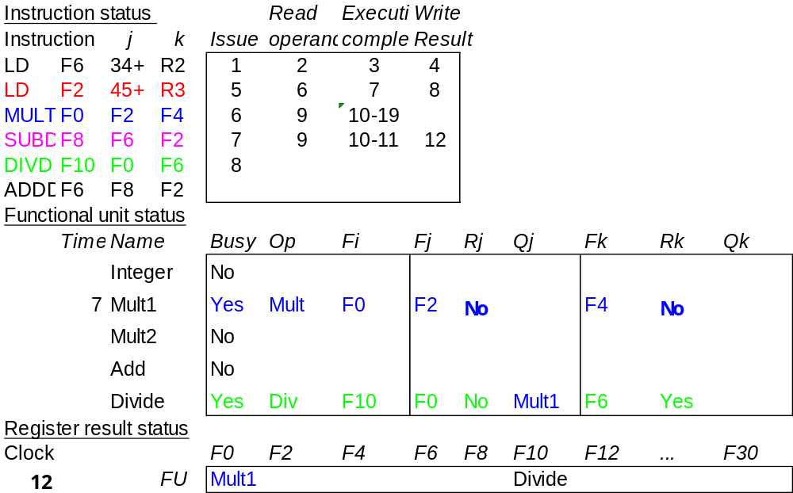
Scoreboard Example Cycle 12
SUBD finishes.
DIVD waiting for F0.

Slide 26
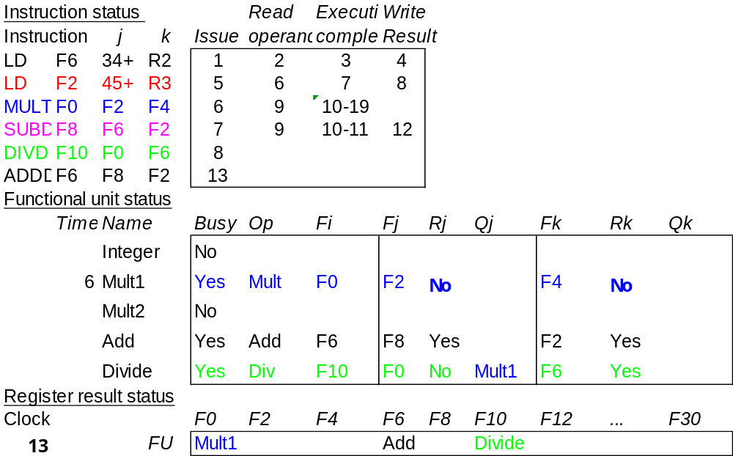
Scoreboard Example Cycle 13
ADDD is issued.
Since FP Add unit is mde free just now.

Slide 27
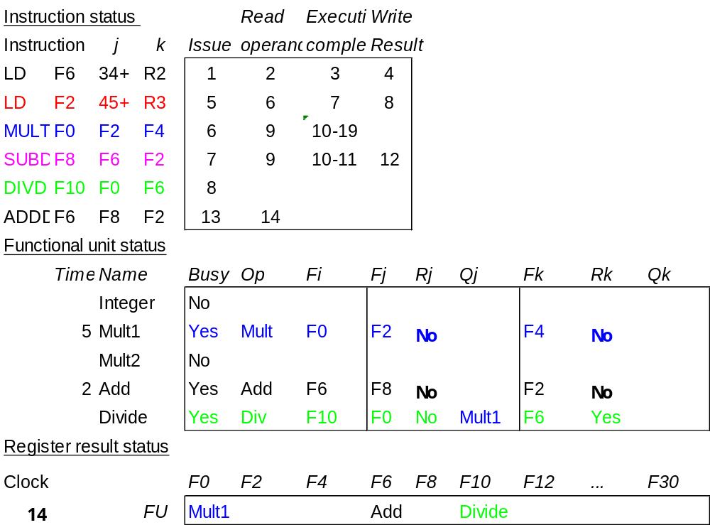
Scoreboard Example Cycle 14

Slide 28
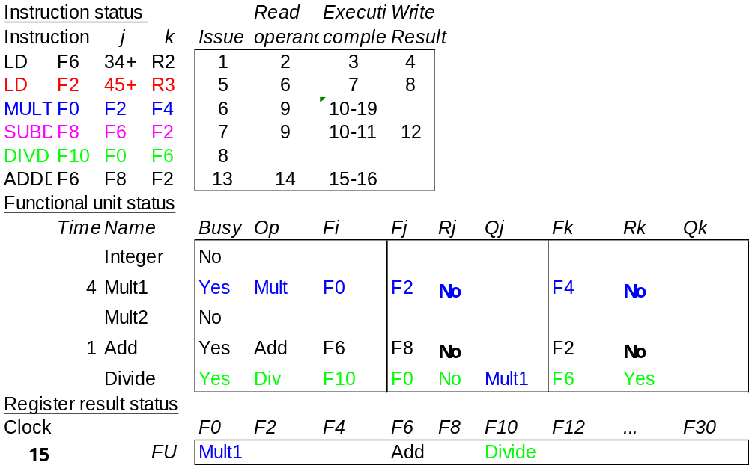
Scoreboard Example Cycle 15

Slide 29
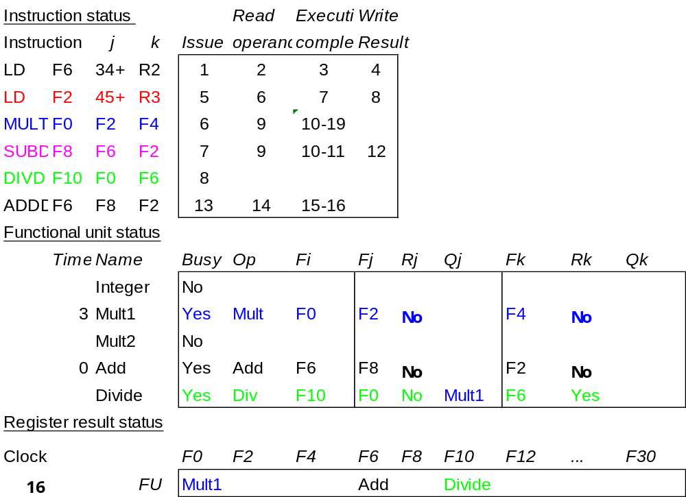
Scoreboard Example Cycle 16

Slide 30
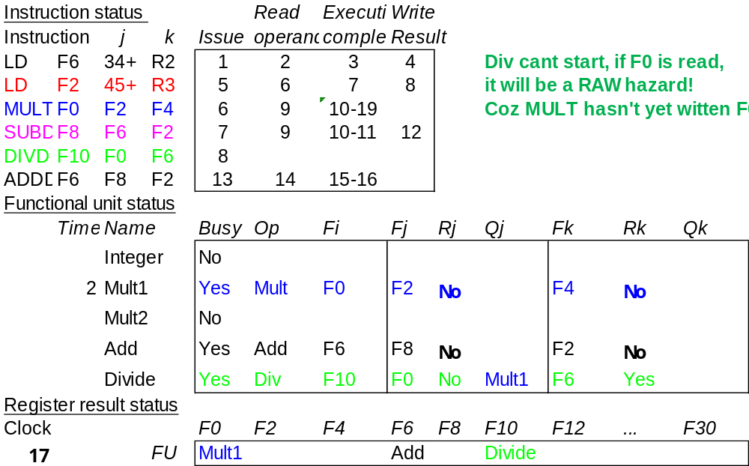
Scoreboard Example Cycle 17
ADDD can’t write because of DIVD.
WAR Hazard!

Slide 31
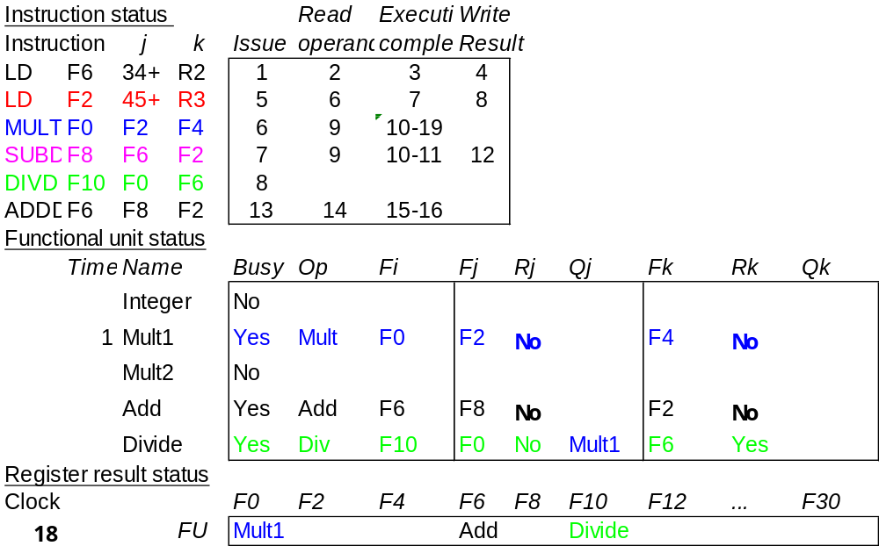
Scoreboard Example Cycle 18
No change in Scoreboard, MULT continues!!
ADDD waiting for F6 to be read by DIVD
DIVD is waiting for F0 to be written by MULT

Slide 32
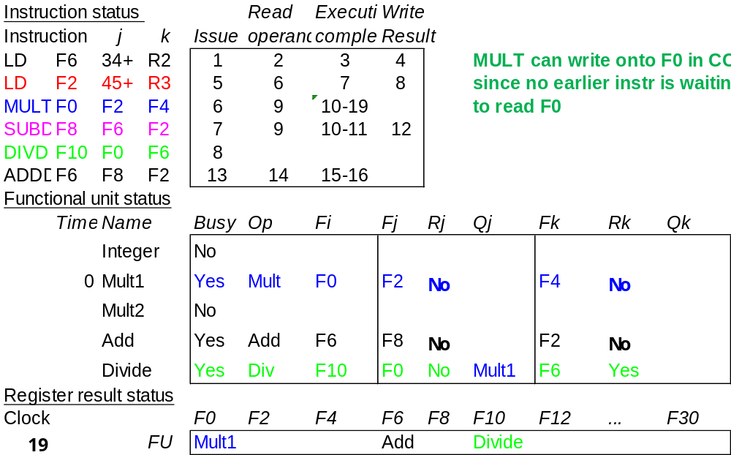
Scoreboard Example Cycle 19
MULT completes execution.

Slide 33
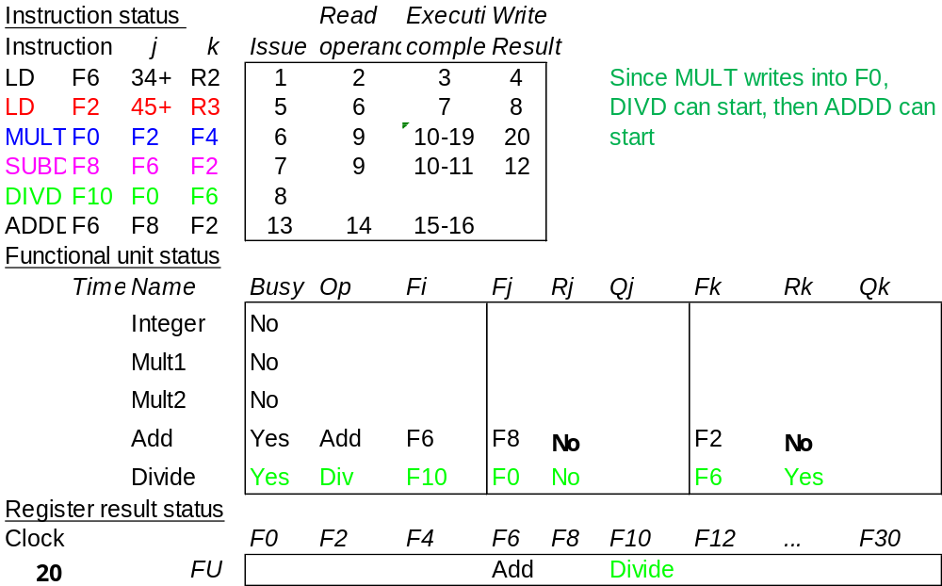
Scoreboard Example Cycle 20
MULT writes.
At the end of CC20, Rj of DIV is made “Yes”

Slide 34
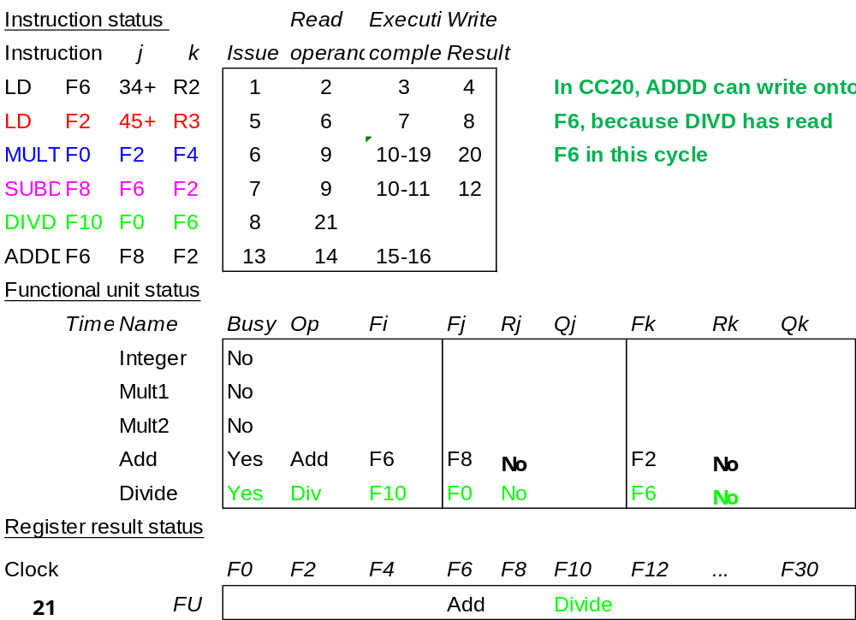
Scoreboard Example Cycle 21
DIVD loads operands

Slide 35
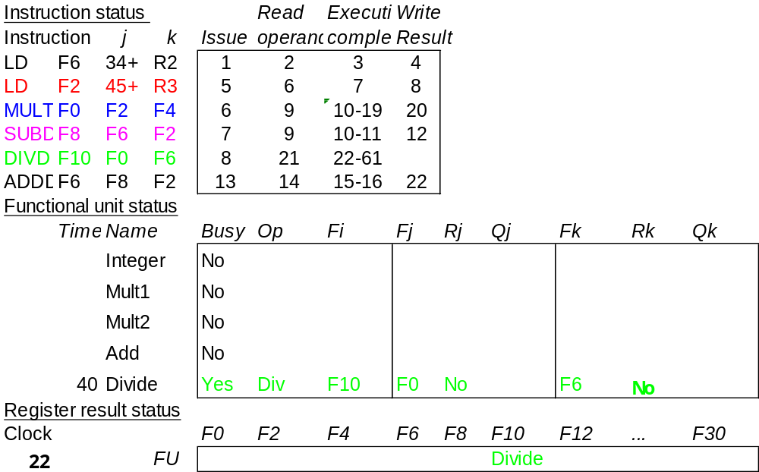
Scoreboard Example Cycle 22
Now ADDD can write since WAR removed.

Slide 36
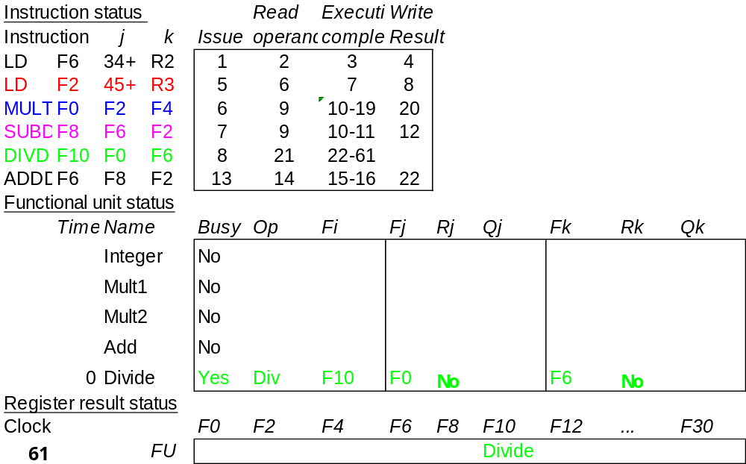
Scoreboard Example Cycle 61
DIVD completes execution

Slide 37
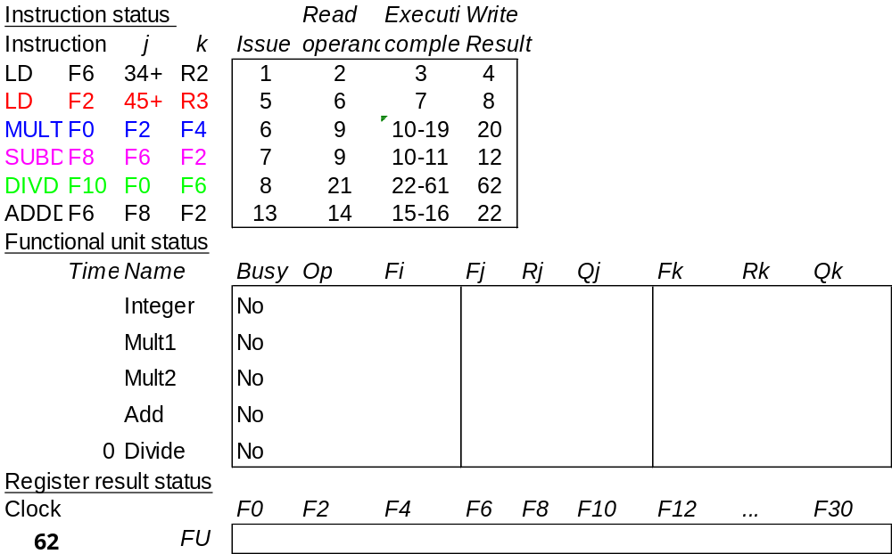
Scoreboard Example Cycle 62
DONE!!

Slide 38
Detailed Scoreboard Pipeline Control
Instruction status
Wait until
Bookkeeping
Issue
Not busy (FU) and not result(D)
Busy(FU)← yes; Op(FU)← op;
Fi(FU)← `D’; Fj(FU)← `S1’;
Fk(FU)← `S2’; Qj← Result(‘S1’);
Qk← Result(`S2’); Rj← not Qj;
Rk← not Qk; Result(‘D’)← FU;
Read operands
Rj and Rk
Rj← No; Rk← No
Execution complete
Functional unit done
Write result
∀f((Fj( f )≠Fi(FU)
or Rj( f )=No) & (Fk( f ) ≠Fi(FU) or
Rk( f )=No))
∀f(if Qj(f)=FU then Rj(f)← Yes);
∀f(if Qk(f)=FU then Rj(f)← Yes); Result(Fi(FU))← 0; Busy(FU)← No
Notes:
1.Issue - if no structural haards AND non wAW (no Funtional Unit is going to write this destination register; 1 per clock cycle
2. Read -(RAW) if no instructions is going to write a source register of this instruction (alternatively, no write signal this clock cycle) +> gein exection of the instruction; many read ports, so can read many times
3. Execution Complete; multiple during clock cyle
4. Write result - (WAR) If no instructiion is watiing to read the destination register; assume multiple wriite ports; wait for clock cycle to write and tehn read the results; assume can oerlap issue & write
show clock cyclesneed 20 or so
Latency: minimum is 4 through 4 stages

Slide 39
Summary
Techniques to deal with data hazards in instruction pipelines by:
  Result forwarding to reduce or eliminate RAW hazards
  Hazard detection hardware to stall the pipeline during hazards
  Compiler-based static scheduling to separate the dependent instructions minimizing actual hazard-prevention stalls in scheduled code (will discuss in detail next week.)
  Uses a hardware-based mechanism to rearrange instruction execution order to reduce stalls dynamically at runtime (dynamic scheduling)
    Better dynamic exploitation of instruction-level parallelism (ILP)
    We learned scoreboard techniques today
    We will learn another technique Tomasulo next week.
(In Appendix A.8, Chapter 3.2, 3.3)

Slide 40
Typical Scoreboard Structure
2 FP multiply, 1 FP adder, 1 FP divider, 1 integer

Slide 41
Using A Scoreboard: 3 parts
1. Instruction status—which of 4 steps the instruction is in
2. Functional unit status—Indicates the state of the functional unit (FU). 9 fields for each functional unit
Busy—Indicates whether the unit is busy or not
Op—Operation to perform in the unit (e.g., + or –)
Fi—Destination register
Fj, Fk—Source-register numbers
Qj, Qk—Functional units producing source registers Fj, Fk
Rj, Rk—Flags indicating when Fj, Fk are ready. Set to No after operands are read.
3. Register result status—Indicates which functional unit will write each register, if one exists. Blank when no pending instructions will write that register
Notes:
What you might have thought
1. 4 stages of instruction executino
2.Status of FU: Normal things to keep track of (RAW & structura for busyl):
Fi from instruction format of the mahine (Fi is dest)
Add unit can Add or Sub
Rj, Rk - status of registers (Yes means ready)
Qj,Qk - If a no in Rj, Rk, means waiting for a FU to write result; Qj, Qk means wihch FU waiting for it
3.Status of register result (WAW &WAR)s:
which FU is going to write into registers
Scoreboard on 6600 = size of FU
6.7, 6.8, 6.9, 6.12, 6.13, 6.16, 6.17
FU latencies: Add 2, Mult 10, Div 40 clocks

Slide 42
A Scoreboard Example
The following code is run on the MIPS with a scoreboard given earlier with:
    L.D F6, 34(R2)
    L.D F2, 45(R3)
    MUL.D F0, F2, F4
    SUB.D F8, F6, F2
    DIV.D F10, F0, F6
    ADD.D F6, F8, F2
Functional Unit (FU) # of FUs EX cycles
Integer 1 1
Floating Point Multiply 2 10
Floating Point add 1 2
Floating point Divide 1 40

Slide 43
Dependency Graph For Example Code
1
Example Code
L.D F6, 34 (R2)
1
2
3
4
5
6
L.D F6, 34(R2)
L.D F2, 45(R3)
MUL.D F0, F2, F4
SUB.D F8, F6, F2
DIV.D F10, F0, F6
ADD.D F6, F8, F2
2
L.D F2, 45 (R3)
3
MUL.D F0, F2, F4
4
SUB.D F8, F6, F2
5
DIV.D F10, F0, F6
Real Data Dependence (RAW)
Anti-dependence (WAR)
Output Dependence (WAW)
6
ADD.D F6, F8, F2

Slide 44
Dependency Graph For Example Code
1
Example Code
L.D F6, 34 (R2)
1
2
3
4
5
6
L.D F6, 34(R2)
L.D F2, 45(R3)
MUL.D F0, F2, F4
SUB.D F8, F6, F2
DIV.D F10, F0, F6
ADD.D F6, F8, F2
2
L.D F2, 45 (R3)
3
MUL.D F0, F2, F4
Date Dependence:
(1, 4) (1, 5) (2, 3) (2, 4)
(2, 6) (3, 5) (4, 6)
Output Dependence:
(1, 6)
Anti-dependence:
(5, 6)
4
SUB.D F8, F6, F2
5
DIV.D F10, F0, F6
Real Data Dependence (RAW)
Anti-dependence (WAR)
Output Dependence (WAW)
6
ADD.D F6, F8, F2

Slide 45
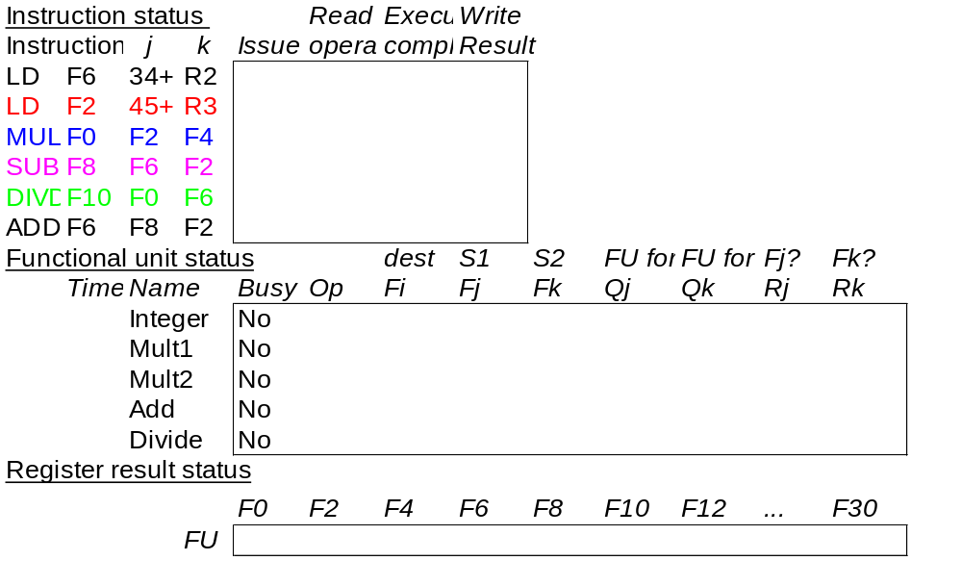
Scoreboard Example

Slide 46
Detailed Scoreboard Pipeline Control
Instruction status
Wait until
Bookkeeping
Avoid Structural and WAW Hazards
Issue
Not Busy(FU) and not Result(D)
Busy(FU)← yes; Op(FU)← op;
Fi(FU)← `D’; Fj(FU)← `S1’;
Fk(FU)← `S2’; Qj← Result(‘S1’);
Qk← Result(`S2’); Rj← not Qj;
Rk← not Qk; Result(‘D’)← FU;
Avoid RAW Hazards
Read operands
Rj and Rk
Rj← No; Rk← No
Execution complete
Functional unit done
Write result
∀f((Fj( f )≠Fi(FU)
or Rj( f )=No) & (Fk( f ) ≠Fi(FU)or
Rk( f )=No))
∀f(if Qj(f)=FU then Rj(f)← Yes);
∀f(if Qk(f)=FU then Rj(f)← Yes); Result(Fi(FU))← 0; Busy(FU)← No
Avoid WAR Hazards
Notes:
1.Issue - if no structural haards AND non wAW (no Funtional Unit is going to write this destination register; 1 per clock cycle
2. Read -(RAW) if no instructions is going to write a source register of this instruction (alternatively, no write signal this clock cycle) +> gein exection of the instruction; many read ports, so can read many times
3. Execution Complete; multiple during clock cyle
4. Write result - (WAR) If no instructiion is watiing to read the destination register; assume multiple wriite ports; wait for clock cycle to write and tehn read the results; assume can oerlap issue & write
show clock cyclesneed 20 or so
Latency: minimum is 4 through 4 stages

Slide 47
Limitations of Scoreboard
The amount of parallelism available among the instructions (chosen from the same basic block)
The number of score entries (The size of the scoreboard determines the size of the window)
The number and types of functional units (Structural hazards increase when dynamic scheduling is used)
The presence of antidependence and output dependences lead to WAR and WAW stalls.
(In Appendix A.8, Chapter 3.2, 3.3)

